Slide 1
Beyond n-grams: Building and Evaluating Language Models
using Deep NN methods
Gaurav Trivedi, Amin Tajgardoon
Intelligent Systems Program

Slide 2
Overview
Introduction
N-gram models
Deep Neural Network models
Building the language model
Evaluation
Conclusion

Slide 3
Introduction
Language modeling forms the core of most NLP applications:
speech recognition
machine translations
spelling correction
text classification
and many more…
Notes:
Language model is a mapping between words and their meanings to other words.
We usually try to train a machine to understand this mapping.
Once it learned the words sense and relations, the next problem is putting these words together and create sentences that make sense
If we can do that, then we can say we have language model.
Applications of this LM starts from predicting the next word in a sentence or distinguish how likely a word belongs to a sentence
To …

Slide 4
Introduction
N-grams models have dominated most other techniques in the past few decades for language modeling
More recently, deep neural network based methods have been shown beat benchmarks and have demonstrated success in language modeling
In this project, we explore the state-of-the-art techniques and toolkits introduced recently to build a language model for the Yelp reviews dataset
Notes:
Language model is a mapping between words and their meanings to other words.
We usually try to train a machine to understand this mapping.
Once it learned the words sense and relations, the next problem is putting these words together and create sentences that make sense
If we can do that, then we can say we have language model.
Applications of this LM starts from predicting the next word in a sentence or distinguish how likely a word belongs to a sentence
To …

Slide 5
Overview
Introduction
N-gram models
Deep Neural Network models
Building the language model
Evaluation
Conclusion

Slide 6



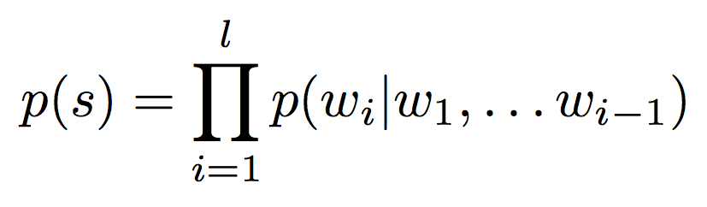
N-gram models
Consider a sentence s as a sequence of words:
Then we can write its probability as:
Notes:
N-grams is a statistical model of language that has been in use for decades.
Assumption: each word only depends on last n-1 word, then we can compute the likelihood of a sequence of words.

Slide 7
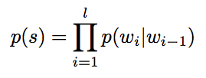

N-gram models
We can restrict the probability of each word to depend on only last n words preceding it
For example, for n=2:
It is straightforward to estimate these probabilities:
Notes:
N-grams is a statistical model of language that has been in use for decades.
Assumption: each word only depends on last n-1 word, then we can compute the likelihood of a sequence of words.

Slide 8
Limitations of n-grams
While it is simple to implement, it has several limitations:
Has no "true" understanding of language
Inefficient representation with large n
joint distribution of 10 consecutive words
vocabulary V of size 100,000
100000¹⁰ − 1 = 10⁵⁰ -1 free parameters
Zero counts and smoothening
Notes:
Sequence of words can be grammatically true or they cam make no sense

Slide 9
Overview
Introduction
N-gram models
Deep Neural Network models
Building the language model
Evaluation
Conclusion

Slide 10
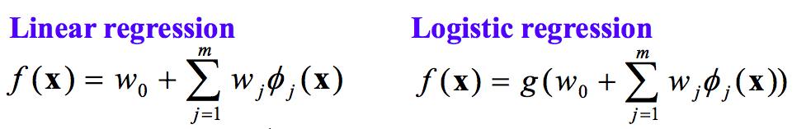
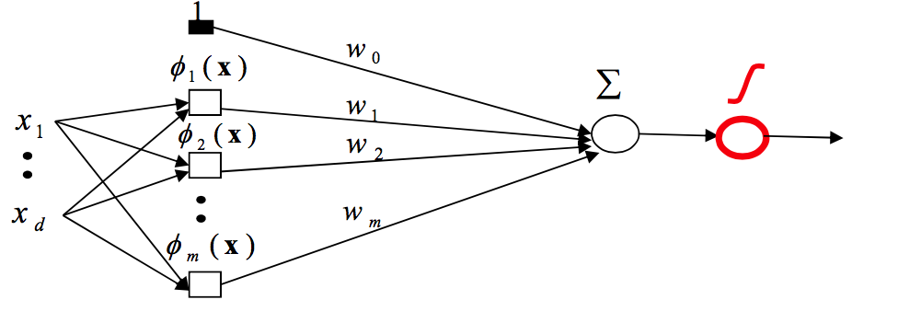
Neural Networks Perceptron
Dr. Hauskrecht’s CS 2750 slides
Notes:
Another approach for modeling language
Neural network based language modeling have shown to been promising in overcoming some of the limitations
of the n-gram methods
They provide very general machine learning methods that can scale well with large data.
Within them, there are certain kinds of neural networks that are more suited for use in language modeling applications

Slide 11
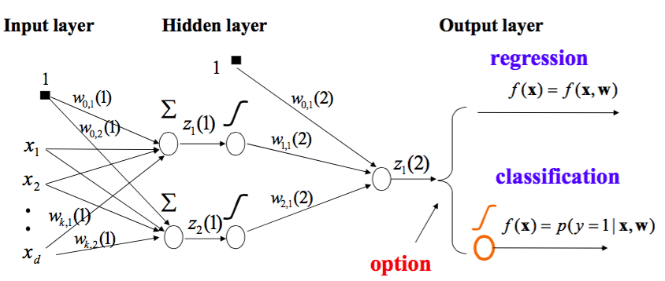
Neural Networks Multi-layer Perceptron
Dr. Hauskrecht’s CS 2750 slides
Notes:
Another approach for modeling language
Neural network based language modeling have shown to been promising in overcoming some of the limitations
of the n-gram methods
They provide very general machine learning methods that can scale well with large data.
Within them, there are certain kinds of neural networks that are more suited for use in language modeling applications

Slide 12
Neural Networks Multi-layer Perceptron
Dr. Hauskrecht’s CS 2750 slides
Notes:
Another approach for modeling language
Neural network based language modeling have shown to been promising in overcoming some of the limitations
of the n-gram methods
They provide very general machine learning methods that can scale well with large data.
Within them, there are certain kinds of neural networks that are more suited for use in language modeling applications

Slide 13
Neural Networks Multi-layer Perceptron
Dr. Hauskrecht’s CS 2750 slides
Notes:
Another approach for modeling language
Neural network based language modeling have shown to been promising in overcoming some of the limitations
of the n-gram methods
They provide very general machine learning methods that can scale well with large data.
Within them, there are certain kinds of neural networks that are more suited for use in language modeling applications

Slide 14
Neural Networks Multi-layer Perceptron
Dr. Hauskrecht’s CS 2750 slides
Notes:
Another approach for modeling language
Neural network based language modeling have shown to been promising in overcoming some of the limitations
of the n-gram methods
They provide very general machine learning methods that can scale well with large data.
Within them, there are certain kinds of neural networks that are more suited for use in language modeling applications

Slide 15
Language modeling with Deep Neural Networks
Neural networks provide general machine learning methods that scale well with large data
If we can represent our language modeling problem with a neural network, we may be able to learn an efficient representation of the language through the hidden layers
Notes:
Another approach for modeling language
Neural network based language modeling have shown to been promising in overcoming some of the limitations
of the n-gram methods
They provide very general machine learning methods that can scale well with large data.
Within them, there are certain kinds of neural networks that are more suited for use in language modeling applications

Slide 16
Language modeling with Deep Neural Networks
NN architectures used for language modeling:
Feed-forward Neural Network (n-gram NNLM)
Recurrent Neural Network (RNN)
Long Short Term Memory (LSTM)
:
:
(more to come)
Notes:
Another approach for modeling language
Neural network based language modeling have shown to been promising in overcoming some of the limitations
of the n-gram methods
They provide very general machine learning methods that can scale well with large data.
Within them, there are certain kinds of neural networks that are more suited for use in language modeling applications

Slide 17
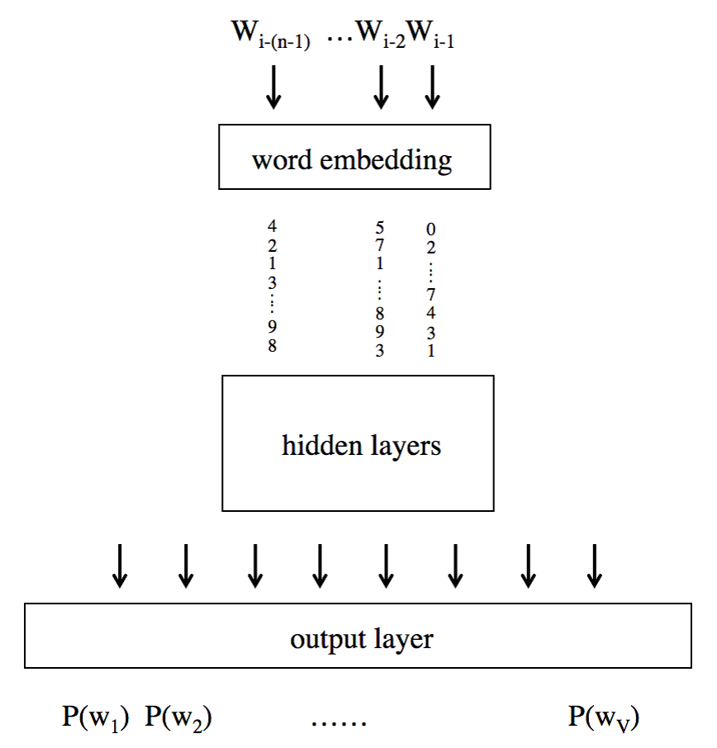
Feed-forward Neural Network
Bengio et al. 2003 proposed building an n-gram NN language model (n-gram NNLM)
Input to the NN is the history of n-1 words (like in n-grams)
Each word is converted to a vector using a coding-scheme:
eg. 1-of-V scheme
Notes:
These embeddings can be randomly initialized or using some other techniques like using embeddings from a pre-trained model.
Each word as a set of numbers before being fed into the network
The numbers are manipulated over time during the training
followed by a series of hidden layers representing non-linear operations on them
The size of the output layer was kept same as the size of the full vocabulary.
feedforward neural networks do not have a notion of time or experience. So for example seeing the same set of n-grams again in the same sentence will have no difference in the prediction

Slide 18
Feed-forward Neural Network
These vectors are projected onto a lower dimension in the first layer using some sort of lookup table or a projection matrix
Embeddings can be randomly assigned or also learned separately as a different learning problem
Notes:
These embeddings can be randomly initialized or using some other techniques like using embeddings from a pre-trained model.
Each word as a set of numbers before being fed into the network
The numbers are manipulated over time during the training
followed by a series of hidden layers representing non-linear operations on them
The size of the output layer was kept same as the size of the full vocabulary.
feedforward neural networks do not have a notion of time or experience. So for example seeing the same set of n-grams again in the same sentence will have no difference in the prediction

Slide 19
Feed-forward Neural Network
Followed by a series of hidden layers performing non-linear operations on the inputs
Notes:
These embeddings can be randomly initialized or using some other techniques like using embeddings from a pre-trained model.
Each word as a set of numbers before being fed into the network
The numbers are manipulated over time during the training
followed by a series of hidden layers representing non-linear operations on them
The size of the output layer was kept same as the size of the full vocabulary.
feedforward neural networks do not have a notion of time or experience. So for example seeing the same set of n-grams again in the same sentence will have no difference in the prediction

Slide 20
Feed-forward Neural Network
Size of the output layer is same as the size of the full vocabulary
The network is trained by setting the the output nodes as the probability of each word P(w_{i}) given the history of n words
Notes:
These embeddings can be randomly initialized or using some other techniques like using embeddings from a pre-trained model.
Each word as a set of numbers before being fed into the network
The numbers are manipulated over time during the training
followed by a series of hidden layers representing non-linear operations on them
The size of the output layer was kept same as the size of the full vocabulary.
feedforward neural networks do not have a notion of time or experience. So for example seeing the same set of n-grams again in the same sentence will have no difference in the prediction

Slide 21
Feed-forward Neural Network
Drawback:
This model is very similar to the simple n-grams approach
We still have no “real” notion of time or context for predicting the next word
Notes:
These embeddings can be randomly initialized or using some other techniques like using embeddings from a pre-trained model.
Each word as a set of numbers before being fed into the network
The numbers are manipulated over time during the training
followed by a series of hidden layers representing non-linear operations on them
The size of the output layer was kept same as the size of the full vocabulary.
feedforward neural networks do not have a notion of time or experience. So for example seeing the same set of n-grams again in the same sentence will have no difference in the prediction

Slide 22
Recurrent Neural Network
Backward connections between hidden layers at time t and t-1
As a short-term memory
Remembers past experience
We can potentially model more than just the previous n-1 history [Mikolov et. al., 2010]
W_{i-(n-1)} …W_{i-2}W_{i-1}
word embedding
4 2 1 3 :: 9 8
5 7 1 :: 8 9 3
0 2 :: 7 4 3 1
hidden layers
(time = t)
hidden layers
(time = t-1)
output layer
P(w₁) P(w₂) …… P(w_{V})
Notes:
Apart from all the neurons in the network, it maintains a hidden state that changes as it sees different inputs. This hidden state is analogous to short-term memory. It remembers past experiences and bases its current answer on both the current input as well as past experiences.

Slide 23
Recurrent Neural Network
For example:
I went to the McDonalds ... I ordered a __________
P(burger)?
W_{i-(n-1)} …W_{i-2}W_{i-1}
word embedding
4 2 1 3 :: 9 8
5 7 1 :: 8 9 3
0 2 :: 7 4 3 1
hidden layers
(time = t)
hidden layers
(time = t-1)
output layer
P(w₁) P(w₂) …… P(w_{V})
Notes:
Apart from all the neurons in the network, it maintains a hidden state that changes as it sees different inputs. This hidden state is analogous to short-term memory. It remembers past experiences and bases its current answer on both the current input as well as past experiences.

Slide 24
Recurrent Neural Network
Drawback: Forgets the context too quickly
W_{i-(n-1)} …W_{i-2}W_{i-1}
word embedding
4 2 1 3 :: 9 8
5 7 1 :: 8 9 3
0 2 :: 7 4 3 1
hidden layers
(time = t)
hidden layers
(time = t-1)
output layer
P(w₁) P(w₂) …… P(w_{V})
Notes:
Apart from all the neurons in the network, it maintains a hidden state that changes as it sees different inputs. This hidden state is analogous to short-term memory. It remembers past experiences and bases its current answer on both the current input as well as past experiences.

Slide 25
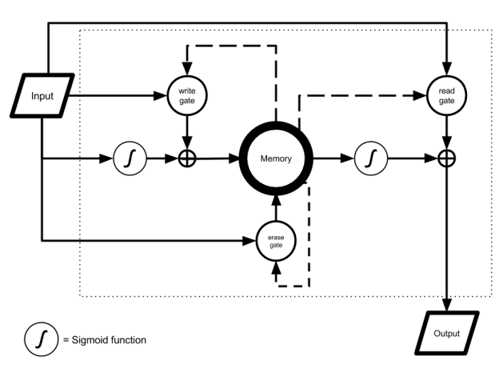
Long Short Term Memory (LSTM) Neural Network
An extension of RNN
Maintain a longer contextual history
Access to memory via “Read/Write/Erase” gates
The parameters for controlling these gates are learned in the network
[picture from nvidia.com]
Notes:
LSTM has multiple gates that act as a differentiable RAM memory
Access to memory cells is guarded by “read”, “write” and “erase” gates
The write gate controls the amount of current input to be remembered for the future,
the read gate controls the amount of the current memory to be given as output to the next stage,
the erase gate controls what part of the memory cell is erased or retained in the current time step.

Slide 26
Overview
Introduction
N-gram models
Deep Neural Network models
Building the language model
Evaluation
Conclusion

Slide 27
Data Analysis and Pre-processing
We considered all only the review fields in the Yelp dataset to build language models
Basic pre-processing steps – converting all the words into lower cases, and passing it through the Stanford Tokenizer
Notes:
We first converted the text to lower case and passed it through the Stanford tokenizer
After analyzing the word frequencies after tokenization step

Slide 28
Frequency dist. of words in Yelp reviews
Data Analysis and Pre-processing
Notes:
We first converted the text to lower case and passed it through the Stanford tokenizer
After analyzing the word frequencies after tokenization step

Slide 29
Vocabulary size at different frequency cut-offs
Notes:
many low frequency words including special names of people, places or objects, and rare spelling error.
These low frequency words may result in a degraded accuracy of the language model, especially in the sentence
generation task.
we replaced the words with less 10 occurrences in the text with the out-of-vocabulary token <unk>.

Slide 30
Vocabulary size at different frequency cut-offs
Notes:
many low frequency words including special names of people, places or objects, and rare spelling error.
These low frequency words may result in a degraded accuracy of the language model, especially in the sentence
generation task.
we replaced the words with less 10 occurrences in the text with the out-of-vocabulary token <unk>.

Slide 31
Building LMs
Model | Toolkit
n-grams | SRILM [Stolcke, 2002]
RNN | RNNLM [Mikolov et al., 2011]
LSTM | [Zaremba et al., 2014]
Notes:
In this project, we have explored building language using three different approaches

Slide 32
Overview
Introduction
N-gram models
Deep Neural Network models
Building the language model
Evaluation
Conclusion

Slide 33
Intrinsic evaluation
Used two data sets: Penn Tree Bank and Yelp Reviews
We split both data sets into 80% for train, 10% for validation,and 10% for test

Slide 34
Intrinsic evaluation
For the smaller Penn Tree Bank dataset, RNN was able to achieve comparable results in 2 hours
LSTM comfortably beat the PPL scores after 1 day of training

Slide 35
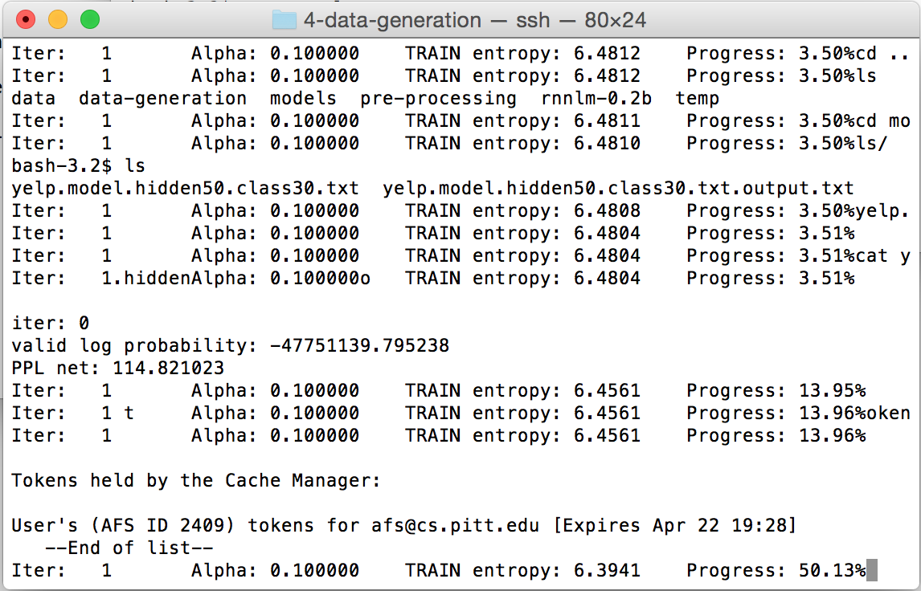
Intrinsic evaluation
Our RNN model is still training!
(Progress as of 11:00 AM today)

Slide 36
Intrinsic evaluation
LSTM hit the 1 GB memoryrestriction in LuaJIT (for Torch) and failed!

Slide 37
Extrinsic evaluation
We had no access to a gold standard dataset to evaluate our models
So we used a group of crowd-workers to evaluate the sentences generated by our (incomplete) models trained till now
Notes:
We used Internet crowdsourcing
to compare the two models. We asked workers on the crowdsourcing site - CrowdFlower [cro, 2015]
to evaluate sentences generated from our language models on a quality scale of 1 to 5 (1 being a very poor
sentence with no meaning at all, See Fig. ??). We considered only the sentences of length 4 or more for this
task. We rewarded the workers with 1 payment cent (in Crowdflower currency) in return for rating every 10
sentences.

Slide 38
Extrinsic Evaluation
Notes:
We used Internet crowdsourcing
to compare the two models. We asked workers on the crowdsourcing site - CrowdFlower [cro, 2015]
to evaluate sentences generated from our language models on a quality scale of 1 to 5 (1 being a very poor
sentence with no meaning at all, See Fig. ??). We considered only the sentences of length 4 or more for this
task. We rewarded the workers with 1 payment cent (in Crowdflower currency) in return for rating every 10
sentences.

Slide 39
Extrinsic Evaluation
We received 1628 reliable ratings for
2000 sentences for $16 within 2 hours
We also inserted some test questions with pre-defined answers for quality control
Notes:
We used Internet crowdsourcing
to compare the two models. We asked workers on the crowdsourcing site - CrowdFlower [cro, 2015]
to evaluate sentences generated from our language models on a quality scale of 1 to 5 (1 being a very poor
sentence with no meaning at all, See Fig. ??). We considered only the sentences of length 4 or more for this
task. We rewarded the workers with 1 payment cent (in Crowdflower currency) in return for rating every 10
sentences.

Slide 40
Crowdsourced ranking results
With the current amount of training, RNNs could not beat trigrams on the Yelp dataset (μ_{trigram} = 2.01, μ_{RNN} = 1.79, p<0.05)
Notes:
we received a rating on a total of 1628 sentences. A comparison of ratings
between the trigram and the RNN model is shown in Fig. 4. We found that the average sentence rating for
the trigram model was better than that of those generated using RNN (p<0.05).

Slide 41
Overview
Introduction
N-gram models
Deep Neural Network models
Building the language model
Evaluation
Conclusion

Slide 42
Conclusion
We explored the recent deep learning methods for building language models.
With the introduction of new libraries and toolkits, the methods have become more accessible to everybody
We had limited amount of training for our nets, but we observe that the PPL scores have been continuously decreasing…
We were able to demonstrate the wins on a smaller Penn Tree Bank Dataset

Slide 43
Future Work
We would also like the try more recent work in the area:
More recent work is coming up related to the design of LSTM units
Further, some very recent work indicates that using characters instead of words to train the network results in better LMs [Zhang et. al., 2015]

Slide 44
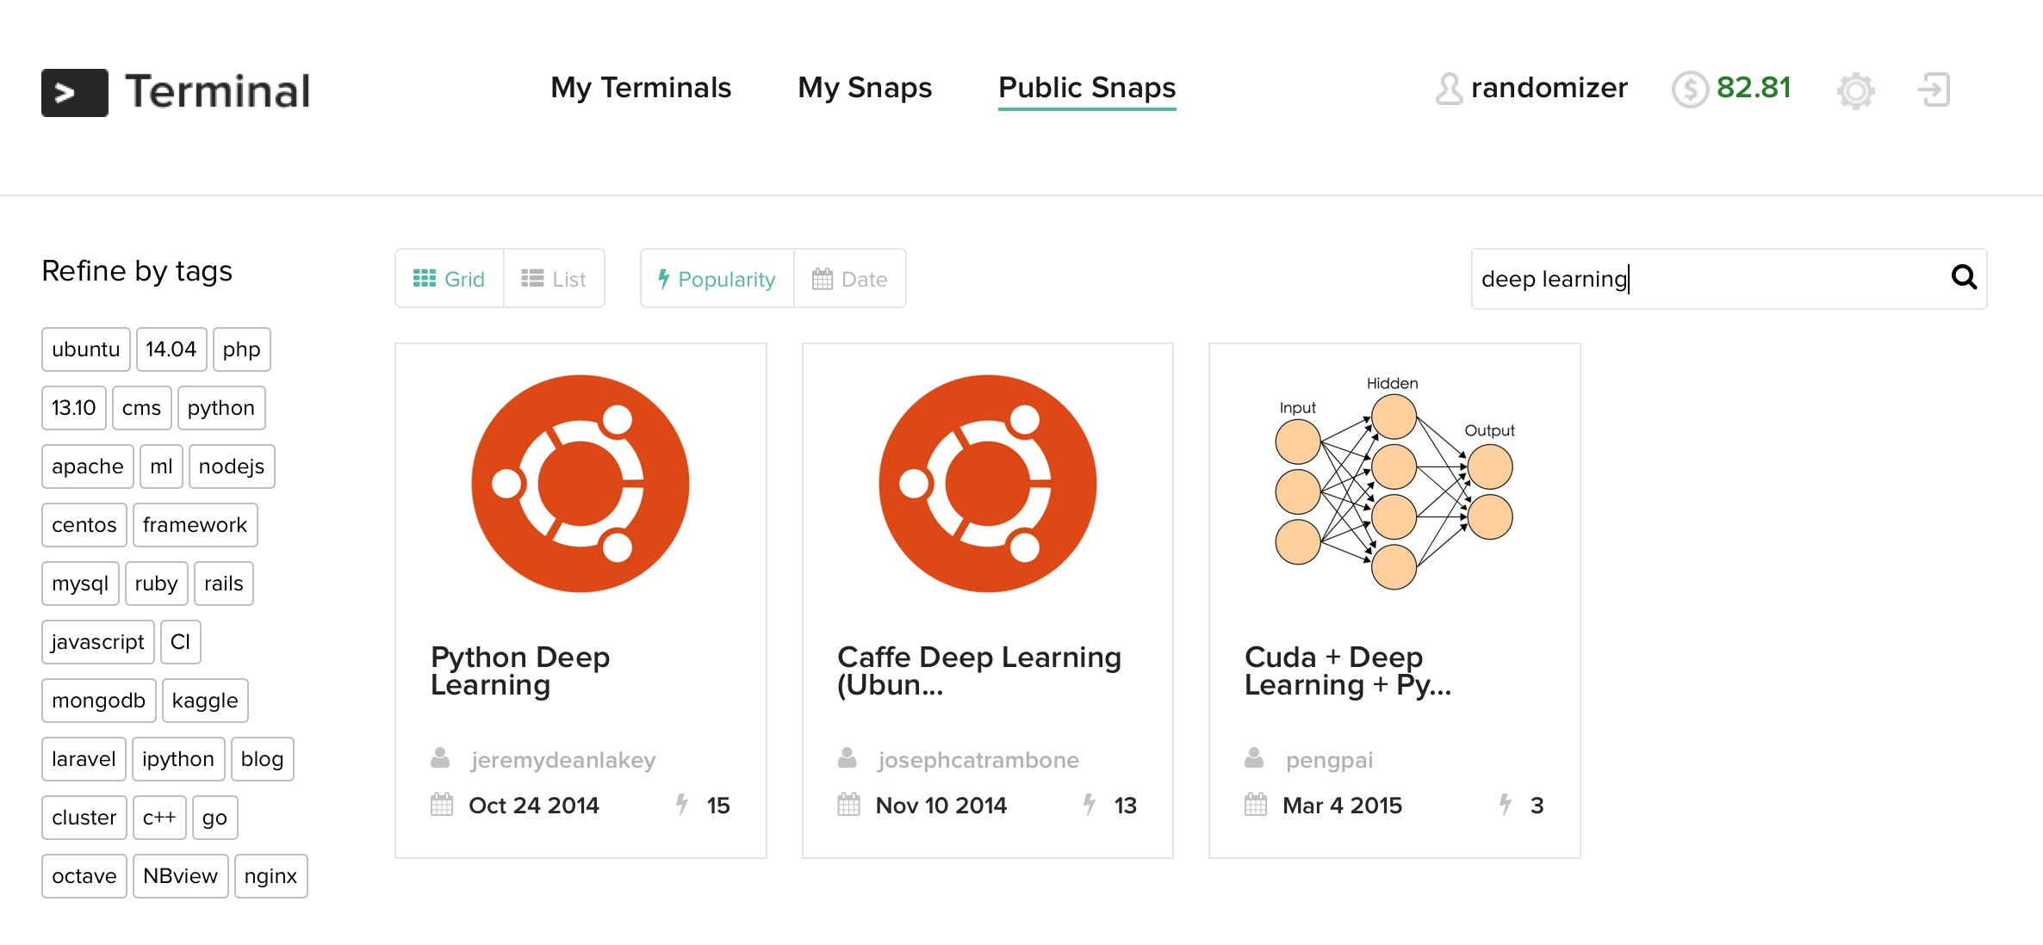

Future Work
To get over our long training time problem:

